Slide 1




Trainer- Anubhav Oberoy

Slide 2


SAP Signavio Training
Anubhav Oberoy
Day-3

Slide 3
Agenda Unit-3
Introduction to SAP Signavio Process Insights
SAP Signavio Process Insights in action
SAP Signavio Process Insights, discovery edition
Introduction to SAP Signavio Process Intelligence
SAP Signavio Process Intelligence: from prerequisites to successful data import
SAP Signavio Process Intelligence in action – part 1
SAP Signavio Process Intelligence in action – part 2

Slide 4
UNIT:3- Analyze and Enhance
3:1-Introduction to SAP Signavio Process Insights
Notes:
https://unsplash.com/photos/L0nipfx-Ry4

Slide 5

Training Overview
1
2
Analyze and Enhance
Introduction
BPM
Fundamentals
3.1 Introduction to SAP Signavio Process Insights
3
4
3.2 SAP Signavio Process Insights in action
Analyze and Enhance
Design
3.3 SAP Signavio Process Insights, discovery edition
5
From Build
To Enablement
3.4 Introduction to SAP Signavio Process Intelligence
3.5 SAP Signavio Process Intelligence: from
prerequisites to successful data import
6
Continuous Improvement
3.6 SAP Signavio Process Intelligence in
action – part 1
3.7 SAP Signavio Process Intelligence in
action – part 2

Slide 6
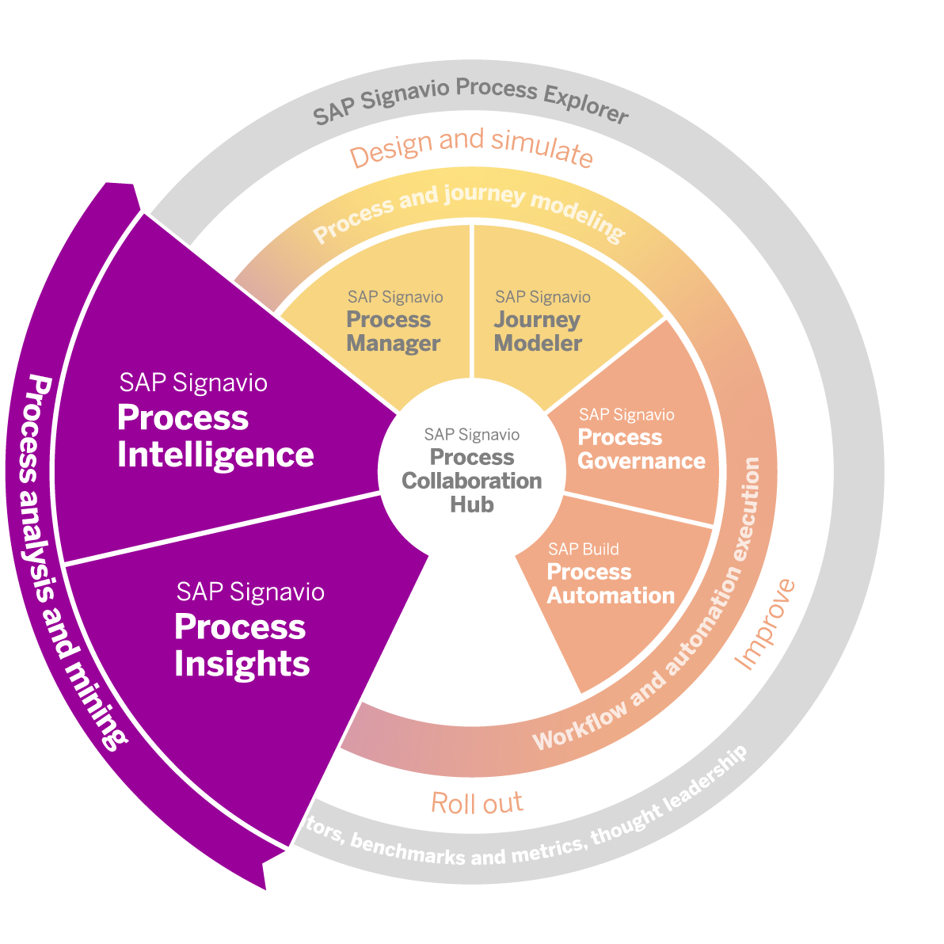
Introduction to SAP Signavio Process Insights
Unique approach for business process transformations
Process analysis and mining
with SAP Signavio solutions
A unified experience to data-driven process improvement as part of SAP Signavio Process Transformation Suite.

Slide 7

Introduction to SAP Signavio Process Insights
Our offering
SAP Signavio Process Insights is a process analytics solution for business executives, process owners, and transformation centers that provides:
A quick start with fast data extraction from SAP ERP environments
Content giving instant insights into the core business
processes of the SAP ERP application
Rapid identification of focus areas with powerful functionality to drill down to potential root causes
Recommended actions and technologies for process
improvements
Benchmarking KPIs with industry best practices

Slide 8









Introduction to SAP Signavio Process Insights
Actionable insights in 24 hours*
End-to-end processes
60+
Process flows
160+
Process performance indicators
Lead to Cash
Plan to Fulfill
Finance
Out of
the box
Source to Pay
Governance
Acquire to Decommission
110+
Correction recommendations
750+
Innovation recommendations
Typical business goals
1 day
Improve Day Payable Outstanding
Improve On-Time Delivery Performance
Improve Procurement FTE Productivity
Improve User Compliance
Reduce Asset Maintenance Cost
Reduce Customer Churn
Reduce Data Management Cost
Reduce Days in Inventory
Reduce Days Sales Outstanding
Reduce Days Close Annual Books
Reduce Finance Cost
Reduce Manufacturing Cycle Time
Reduce Meter Reading to Invoice Cycle Time
Reduce Overall Supply Chain Planning
Cost
Reduce Revenue Loss Due to Stockouts
Reduce Sales Cost
Reduce Service and Support Cost
Reduce Time to Market for New Products
Reduce Total Logistics Cost
Reduce Total Manufacturing Cost
Reduce Unplanned Downtime
1,300+
Metrics
1,000+
Typical issues & inefficiencies
* Reflects best case scenario, actual implementation time may vary

Slide 9



Introduction to SAP Signavio Process Insights
Independent of your transformation scenario
Transformation Scenarios
Improve existing ERP
Transform to SAP S/4HANA
Improve beyond ERP
INITIAL / INCREMENTAL IMPROVEMENT
PRE-OPTIMIZATION
(TOWARDS SAP S/4HAHA –
e.g.: System Conversion)
POST-OPTIMIZATION
(SAP S/4HANA)
INTEGRATION BEYOND ERP
Process-driven or solution-driven ERP transformation approach

Slide 10
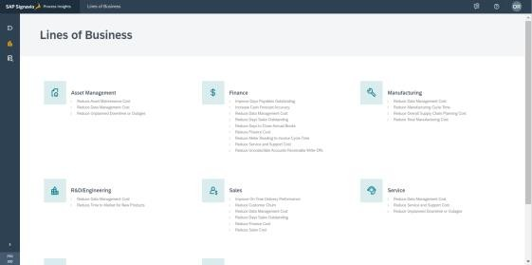
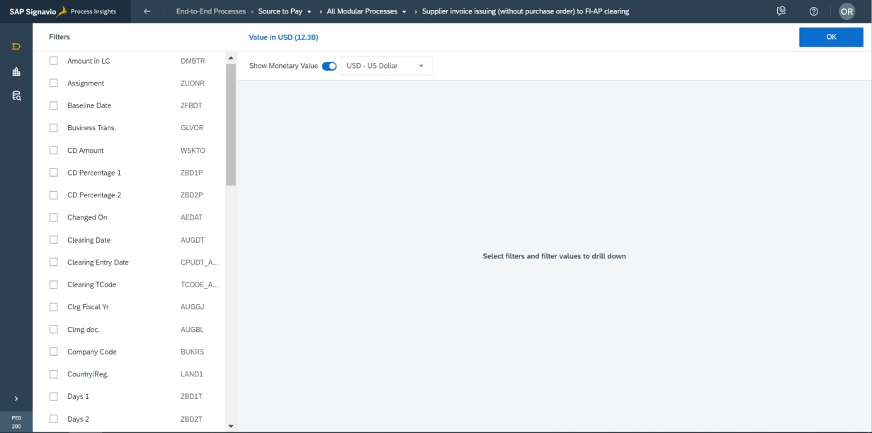
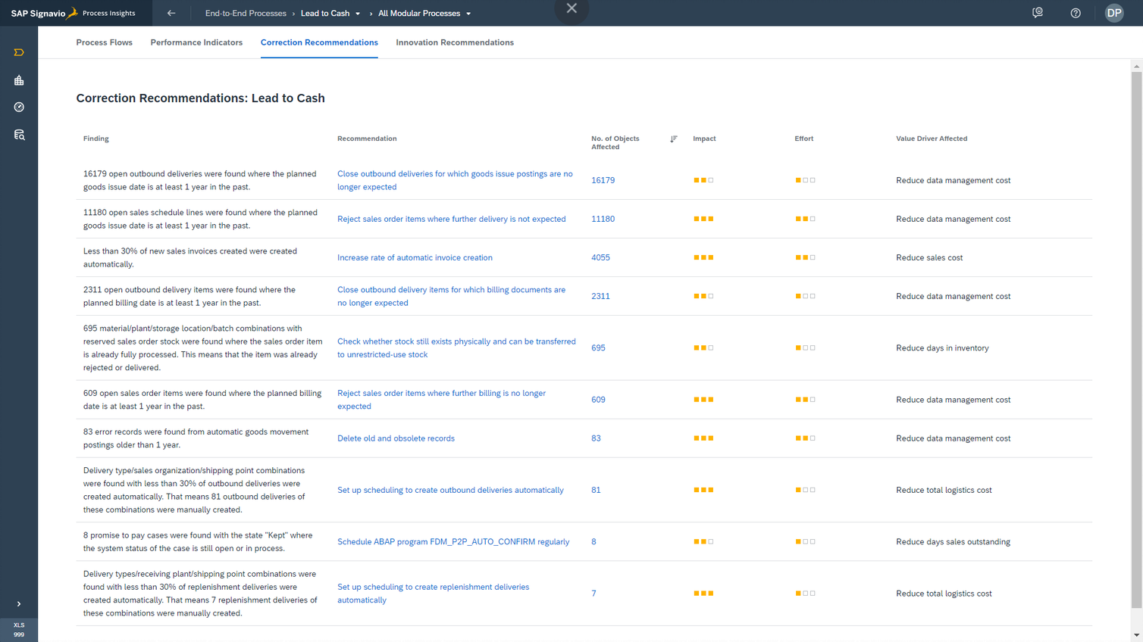
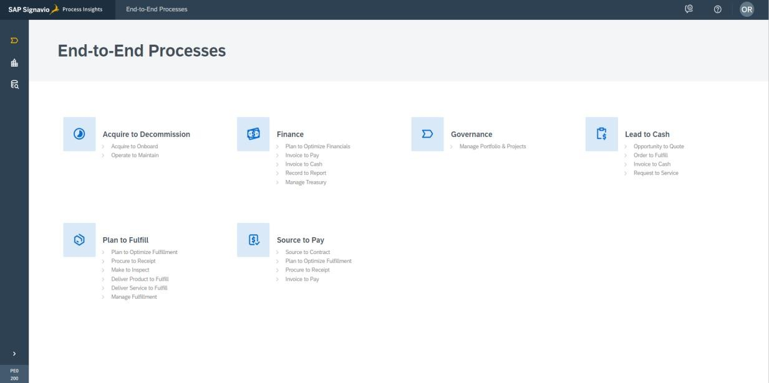
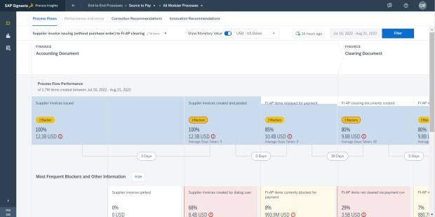
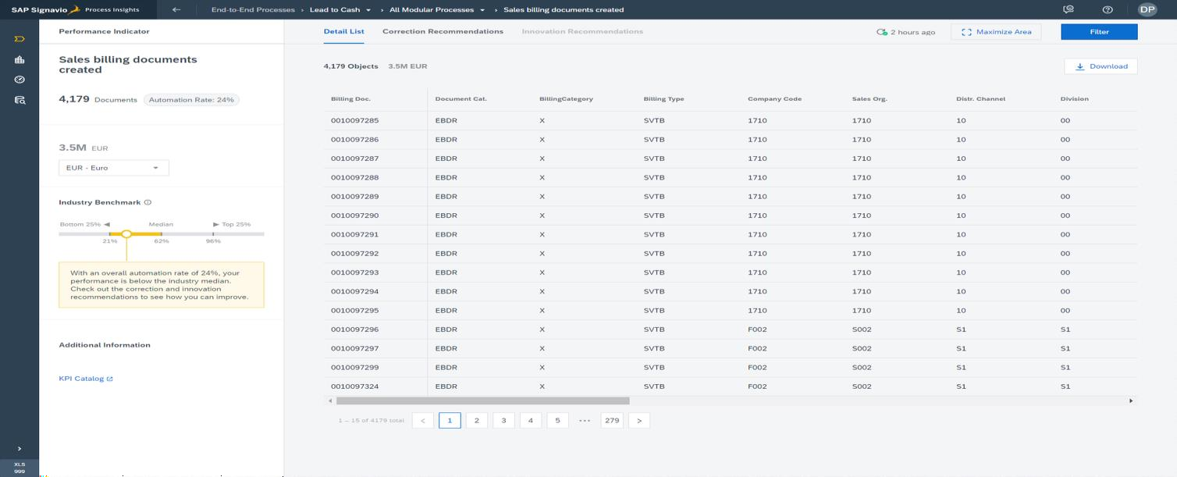
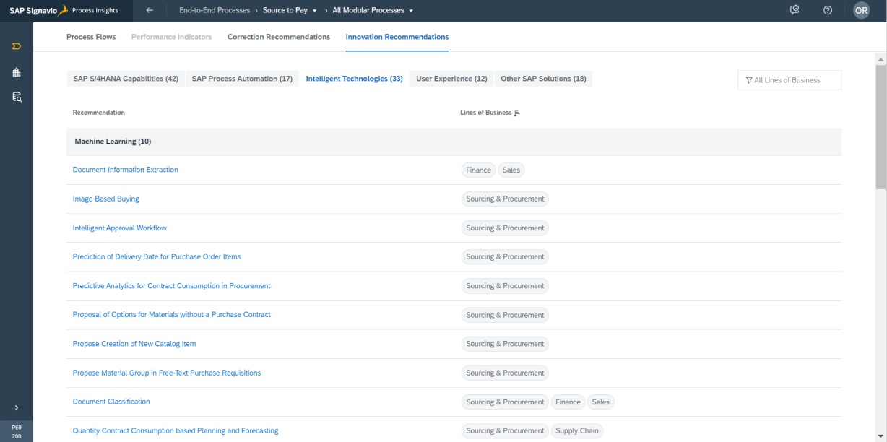
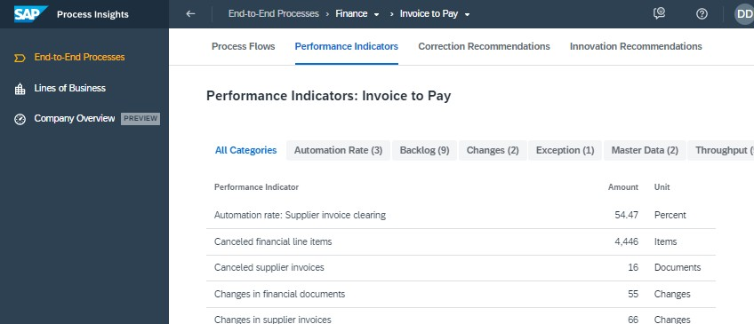

Introduction to SAP Signavio Process Insights
Solve your pain points and discover value fast
DISCOVER IMPROVEMENT AREAS
QUANTIFY VALUE
FIX PAIN POINTS
Overview of Line of Business and End-to-End Processes
Drill-Down and Filtering
Correction Recommendations
MAXIMIZE INVESTMENT
BUILD A FOUNDATION
Process Flows and Blockers
Innovation Recommendations
Process Performance Indicators and Benchmarks

Slide 11

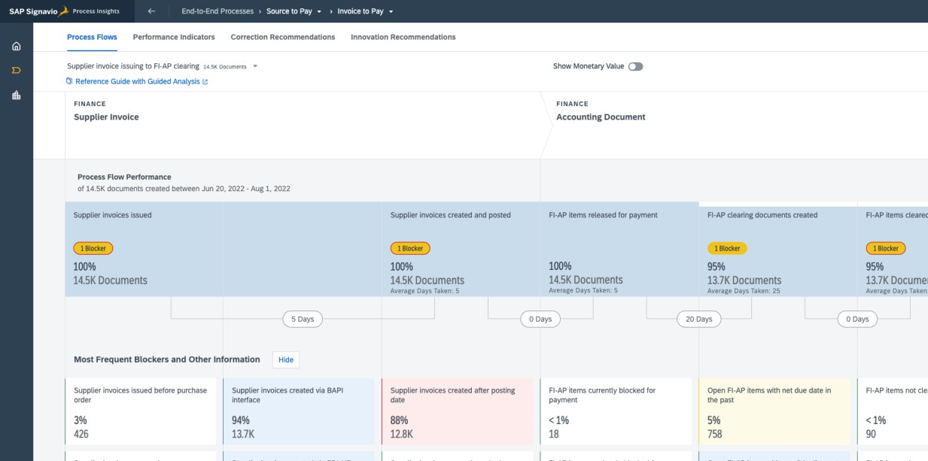
Solve your pain points and discover value fast
Introduction to SAP Signavio Process Insights
DISCOVER IMPROVEMENT AREAS
Lines of Business, End-to-End Processes and Process Flows

Slide 12

Solve your pain points and discover value fast
Introduction to SAP Signavio Process Insights
QUANTIFY VALUE
Drill-Down and Filtering

Slide 13


Solve your pain points and discover value fast
Introduction to SAP Signavio Process Insights
MAXIMIZE INVESTMENT
Innovation Recommendations

Slide 14

Solve your pain points and discover value fast
Introduction to SAP Signavio Process Insights
FIX PAIN POINTS
Correction Recommendations

Slide 15


Solve your pain points and discover value fast
Introduction to SAP Signavio Process Insights
BUILD A FOUNDATION
Process Performance Indicators and Benchmarks

Slide 16
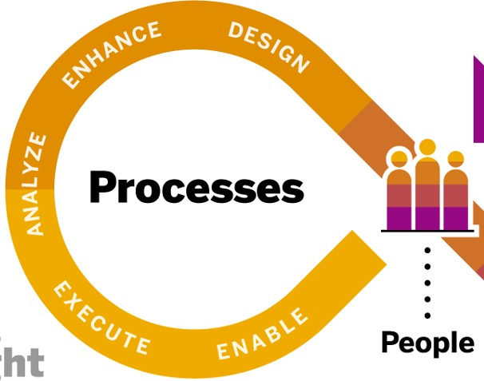
Driving continuous improvement of processes
Introduction to SAP Signavio Process Insights
SAP Signavio Process Insights solution capabilities drive continuous improvement of processes within your SAP systems*
1
Understand your processes
2 Find the root cause of your issues
3 Go from fast insights to immediate results
* Available for SAP ERP, SAP S/4HANA, and SAP S/4HANA Cloud, private edition.

Slide 17
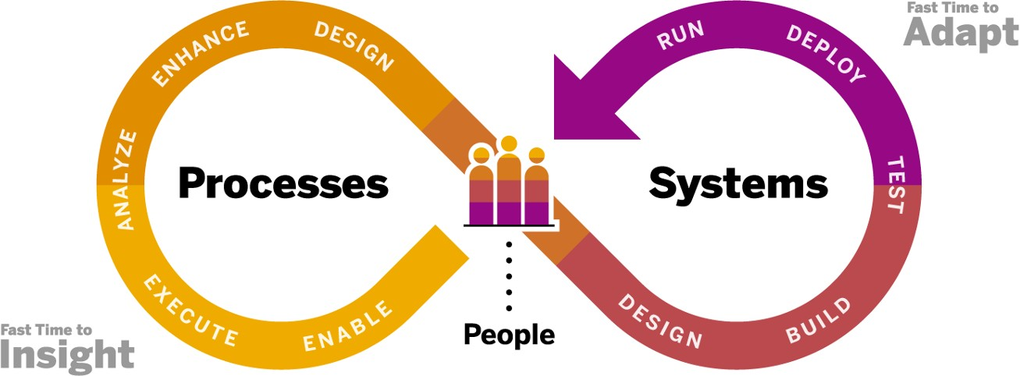
Driving fast business outcomes
Introduction to SAP Signavio Process Insights
A fast and precise approach towards business and process transformation
Advantages for your business
Get a clearer understanding of business processes end-to-end
Benchmark your capabilities and find
out where your issues really are
Foster collaboration
Improve your processes with recommendations
Accelerate time to value
3
2
1

Slide 18

UNIT 3: Analyze and Enhance
3:2- SAP Signavio Process Insights Onboarding and in Action

Slide 19

Our offering
SAP Signavio Process Insights in action
SAP Signavio Process Insights is a process analytics solution for business executives, process owners, and transformation centers that provides:
A quick start with fast data extraction from SAP ERP environments
Content giving instant insights into the core
business processes of the SAP ERP application
Rapid identification of focus areas with powerful functionality to drill down to potential root causes
Recommended actions and technologies for
process improvements
Benchmarking KPIs with industry best practices

Slide 20
Onboarding Guide
https://help.sap.com/docs/BPI/f5642e5272c1465986661c763b56213d/1042eb885d5f4e7182a9c7fb65042fab.html?locale=en-US

Slide 21
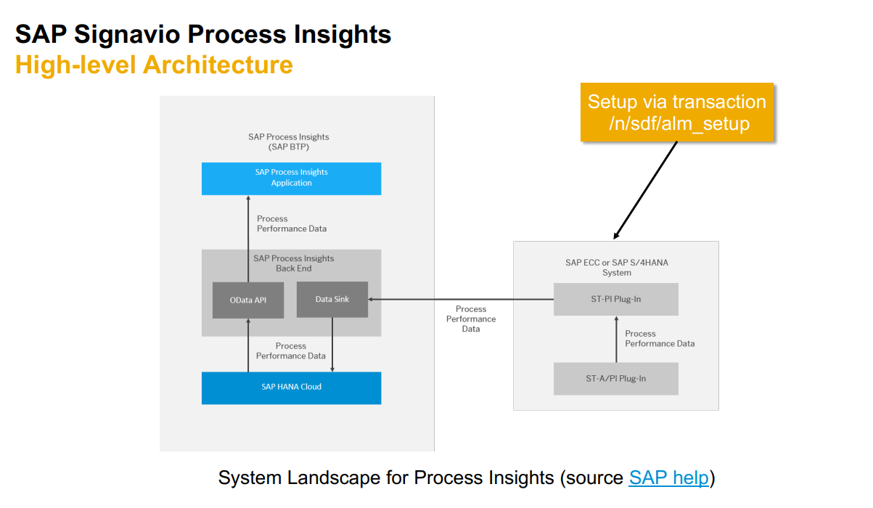

Slide 22































Slide 23
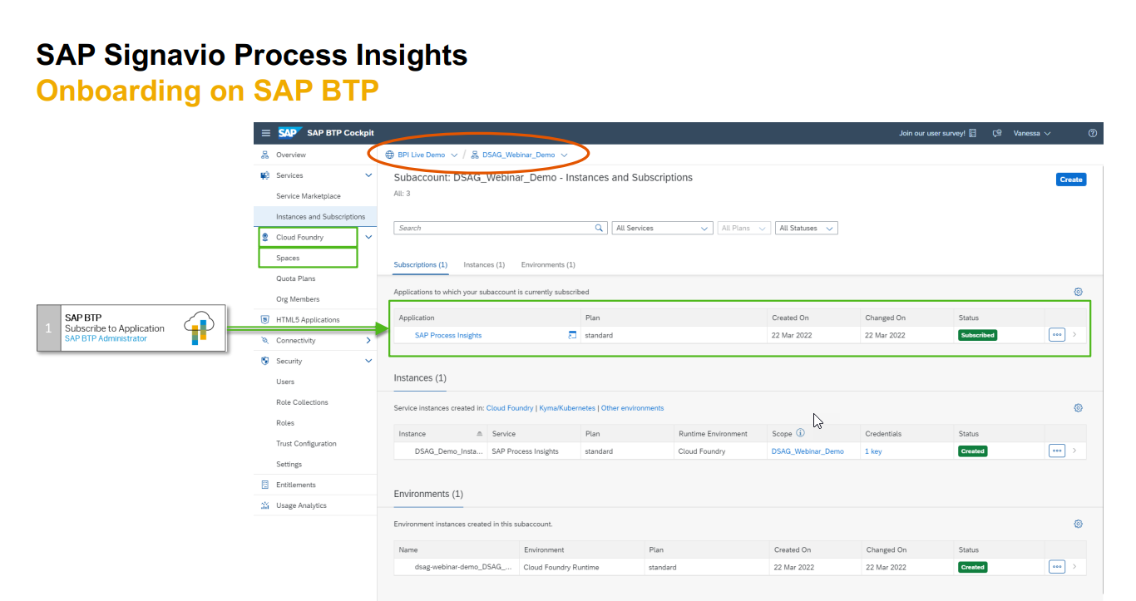

Slide 24
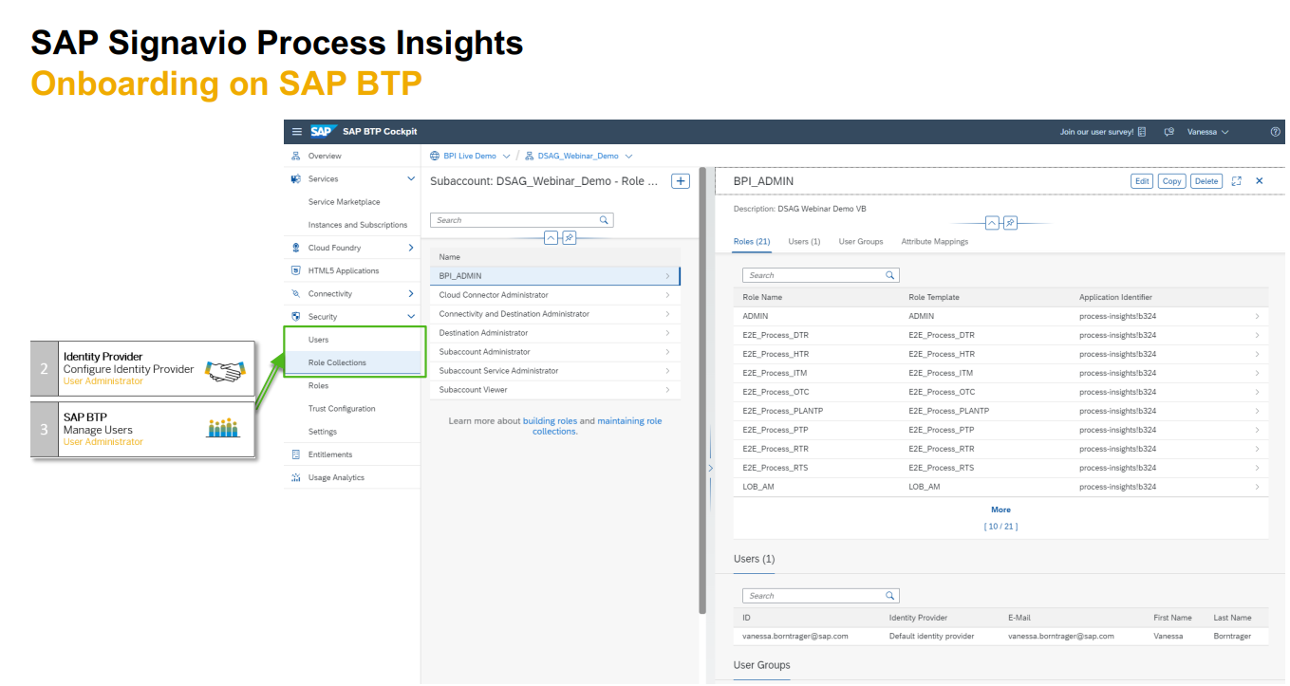

Slide 25
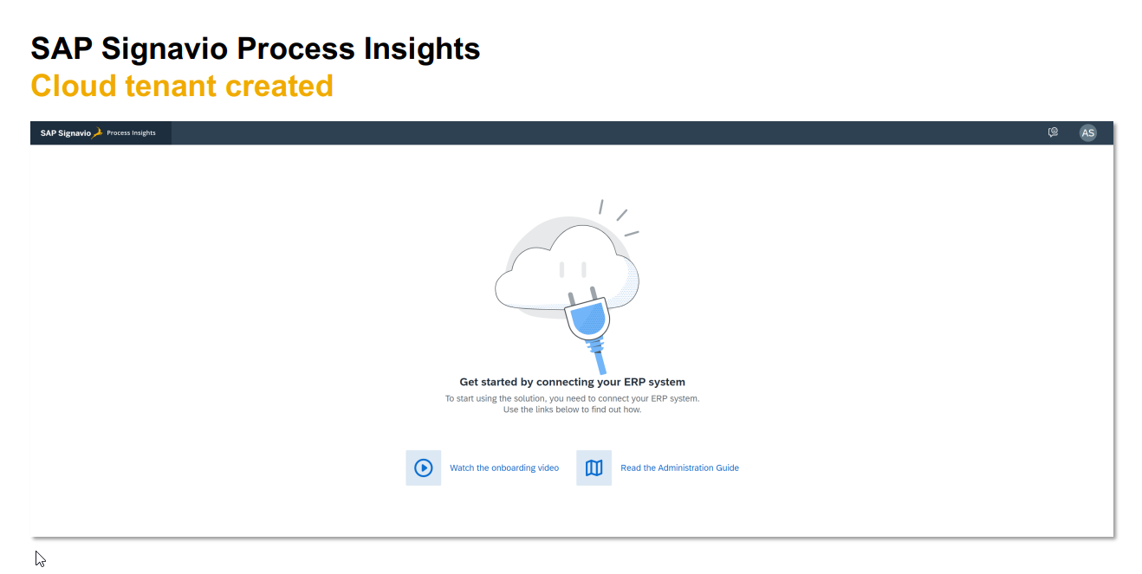

Slide 26
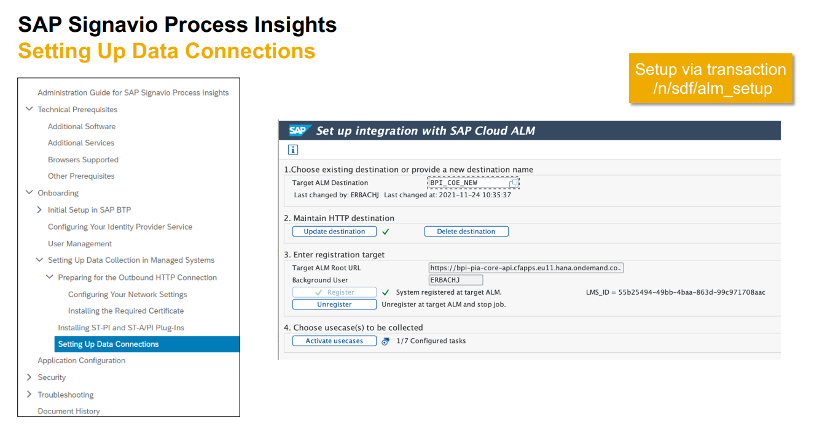

Slide 27
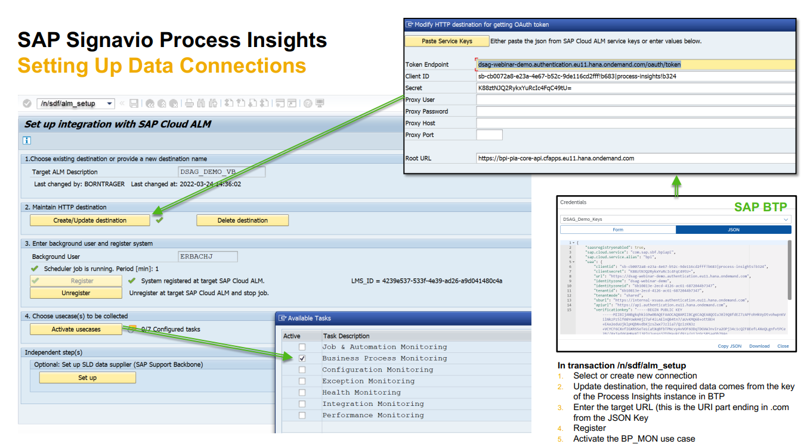

Slide 28
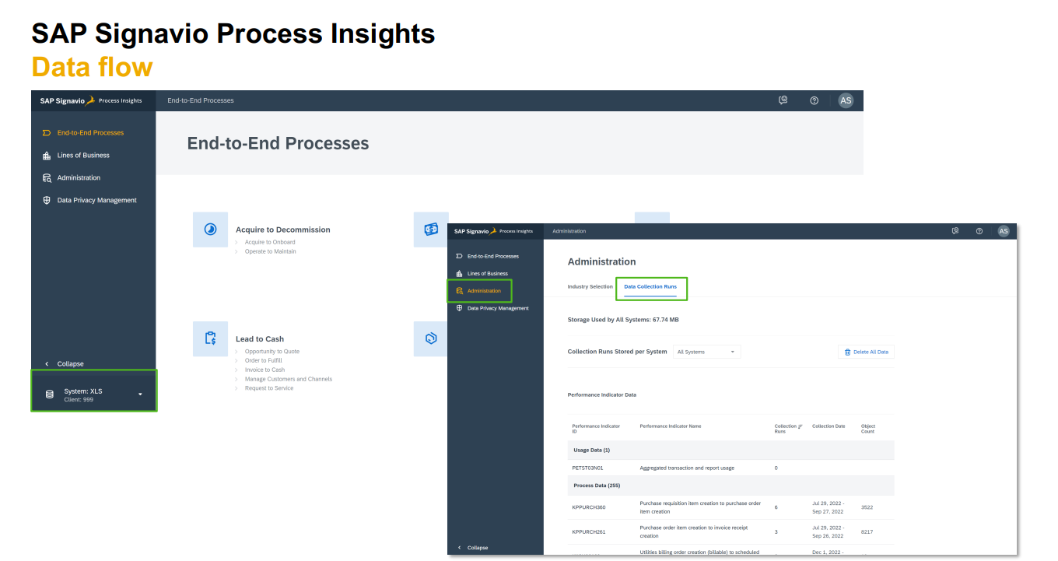

Slide 29
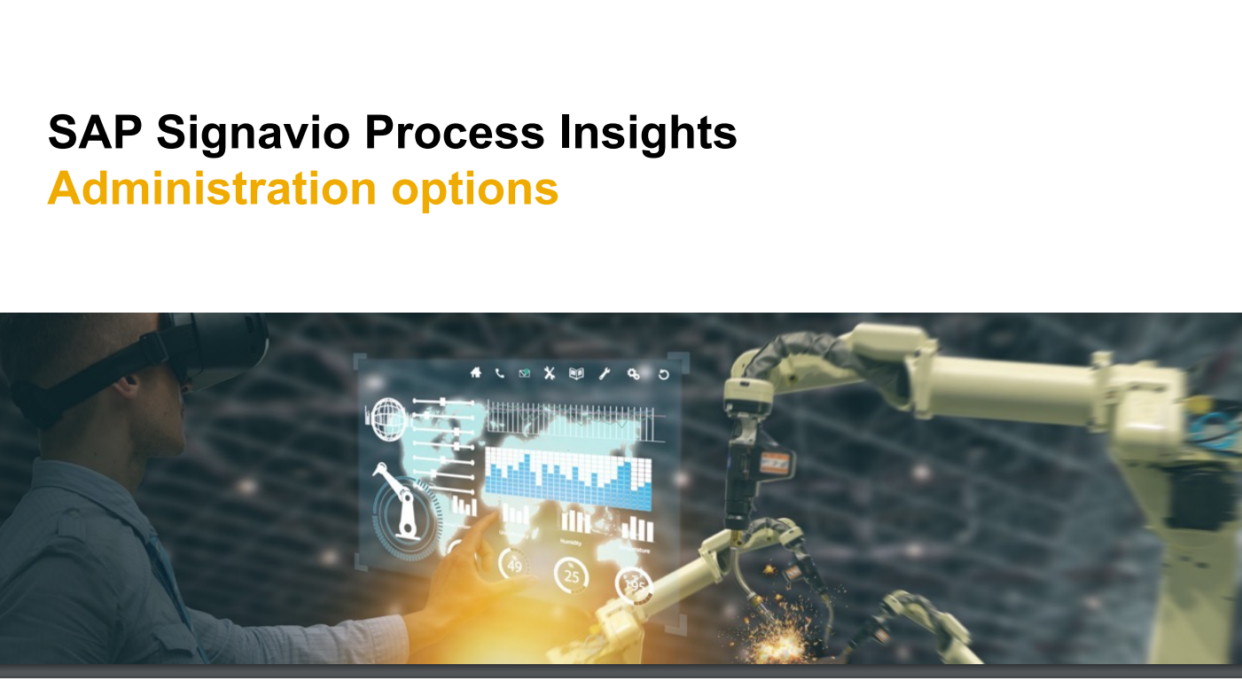

Slide 30
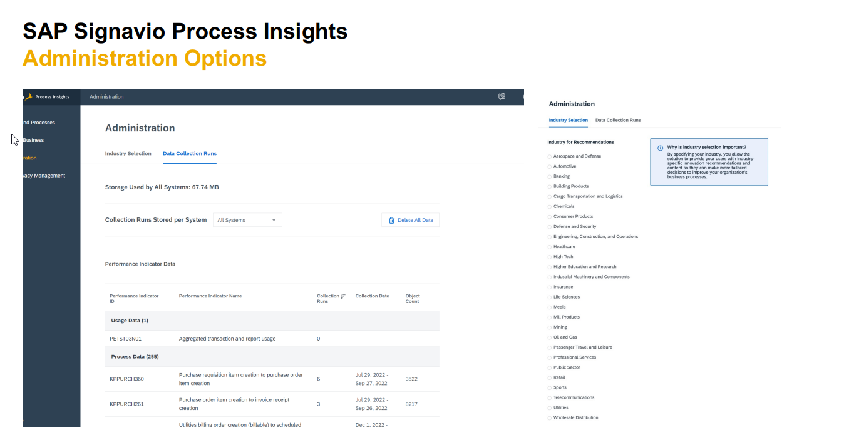

Slide 31
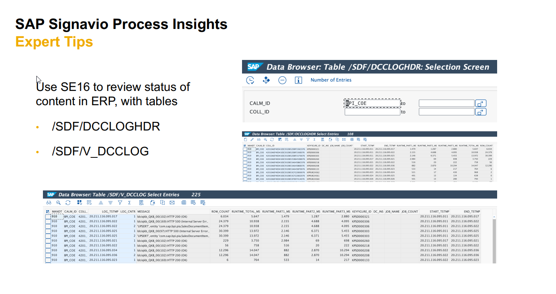

Slide 32
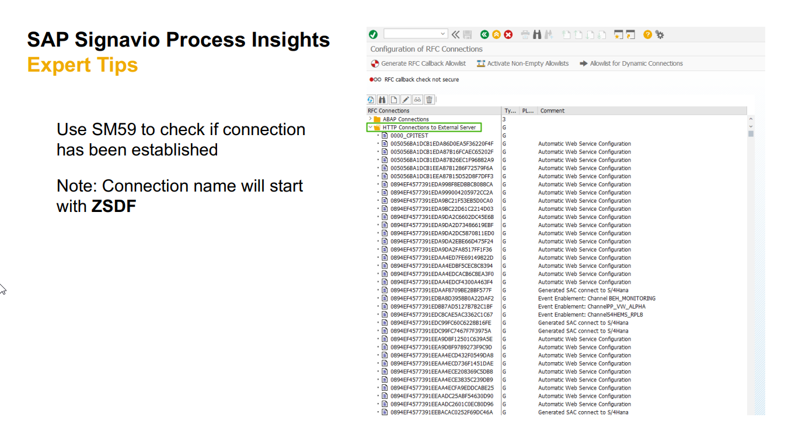

Slide 33





























Slide 34

UNIT 3: Analyze and Enhance
3:3- SAP Signavio Process Insights, Discovery Edition

Slide 35

Introduction
SAP Signavio Process Insights, discovery edition
One free of charge* solution to:
Improve business processes
Start the journey to SAP S/4HANA
Optimize live SAP S/4HANA systems
Get to know the interface and functionality of SAP Signavio Process Insights (both offerings have the same interface)
* For every SAP maintenance customer

Slide 36

What is SAP Signavio Process Insights, discovery edition?
SAP Signavio Process Insights, discovery edition
SAP Signavio
SAP Business Scenario
Recommendations on Spotlight
Process Insights
Sunset 01.2021
Process Discovery
Sunset
2023
SAP Innovation and Optimization Pathfinder on Spotlight
Sunset
2023
SAP Signavio Process Insights, discovery edition
Spotlight by SAP (online application, previously called PIE)
Sunset 2023

Slide 37





Content comparison of different solutions
SAP Signavio Process Insights, discovery edition
Process Discovery
formerly known as Business Scenario Recommendations on Spotlight
SAP Signavio Process Insights, discovery edition
Process Flows
1
>60
Process Flow Detailed Metrics
15
1500
55 48
…
Single PPI
Performance Indicators
…
54
>160
Correction
Recommendations
…
61
>110
358
…
Innovation Recommendations
…
>750
Process Discovery (for SAP ERP systems)
SAP Signavio Process Insights, discovery edition
SAP Innovation and Optimization Pathfinder on Spotlight (for SAP S/4HANA or SAP ERP systems)
SAP Signavio Process Insights

Slide 38
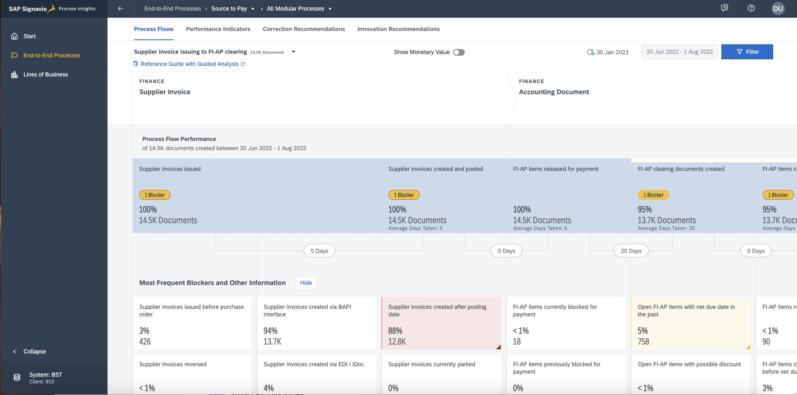
SAP Signavio Process Insights, discovery edition
Special features
Same interface as for SAP Signavio Process Insights
Root cause analysis and detailed information about performance indicators for your processes
Filtering capabilities
Blockers and typical process breaking points (for one process flow)
Detailed list of
documents

Slide 39
SAP Signavio Process Insights, discovery edition
How to request SAP Signavio Process Insights, discovery edition
1. Extract data
2. Initiate your request
3. Confirm your request
4. SAP will share results
Implement the latest version of SAP Notes 2745851 and 2758146 in
SAP ERP production system
Run data extraction report and download ZIP file
Initiate your request – go to: url.sap/discovery- edition*
Fill in the form, upload the extracted ZIP file and submit your request
After submitting your request you receive an e-mail to confirm your e-mail address
SAP back office creates the scenario with your data
SAP emails you the instruction to activate your online SAP Signavio
Process Insights, discovery edition solution account.
Follow-up meetings with your SAP administrator are possible
How-To Guide »
* Currently in BETA Phase, planned for GA in August 2023

Slide 40


UNIT3: Analyze and Enhance
3:4-Introduction to SAP
Signavio Process Intelligence

Slide 41
Introduction to SAP Signavio Process Intelligence
Unique approach for business process transformations
Process analysis and mining
with SAP Signavio solutions
A unified experience to data-driven process improvement as part of SAP Signavio Process Transformation Suite.

Slide 42



Why process mining?
Introduction to SAP Signavio Process Intelligence
All your business processes and stakeholder interactions leave digital traces …
P R O C E S S M I N I N G
… which enable you to create a process digital twin of your business operations and user
behavior …
… to identify execution bottlenecks and inefficiencies and drive intelligent end-to-end process improvements.
Process mining helps you gain visibility over your transformation

Slide 43





Our solution makes processes tangible and performance measurable
Introduction to SAP Signavio Process Intelligence
Building a process digital twin
to understand your operational as-is status
Continuous measurement of your operational performance, based on your company data
Enabling a deep-dive and root- cause analysis on critical operational topics
Implementing data-driven decision making into all levels of your organization
B E N E F I T S W I T H P R O C E S S M I N I N G ( E X A M P L E S )
Reduction of overall
cycle times
Faster invoice processing
Reduction of
delivery blocks
Better internal alignment
Elimination of redundancies and efficiencies
…
Uncompliant process
identification
Reduction of
undesired behavior
Simplified preparation for audit events
Improved link from
strategy to operations

Slide 44





… and helps you bring performance, profitability, and people satisfaction in sync
Introduction to SAP Signavio Process Intelligence
Understand the impact of operational activities on people experience
Continuously monitor the relationship between operational KPIs and experience metrics
Optimize the way you operate and engage while positively affecting the experience
6

Slide 45




Introduction to SAP Signavio Process Intelligence
Supporting multiple transformation initiatives across process domains
Transformation initiatives
Business transformation
Process excellence
Audit and compliance
Automation
Process domains
Any process and system combination (SAP and non-SAP)
Order-to-Cash (O2C) – Procure-to-Pay (P2P) – Accounts Payable (AP) – Incident-to-Resolution (I2R) – Hire-to-Retire (H2R) – IT Service Management (ITSM) – etc.
…

Slide 46
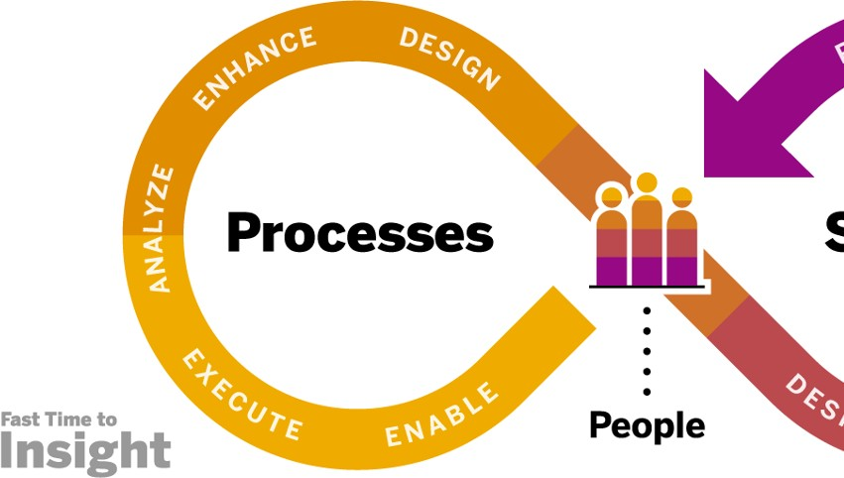
Helping you achieve fast time to insight
Introduction to SAP Signavio Process Intelligence
1
Easily connect to all your data:
systems, data lakes, and data warehouses
2
Jump-start with ready-to-use content:
value accelerators and best practices
3
Quickly discover improvement potential with process mining capabilities

Slide 47
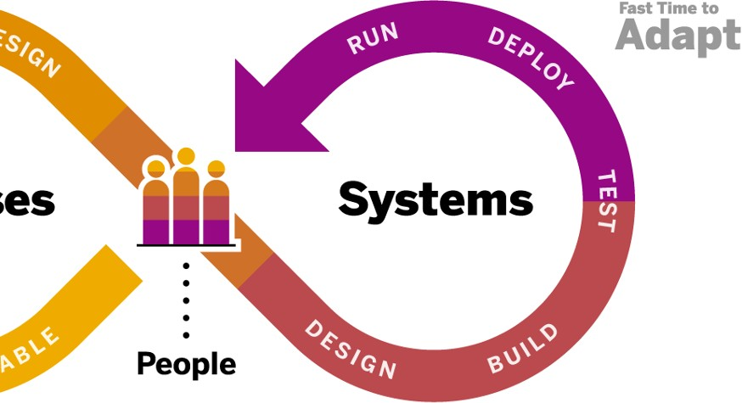
Helping you achieve fast time to adapt
Introduction to SAP Signavio Process Intelligence
4
Process transformation: compare intelligent insights to desired (designed) process template
5
Achieve quick wins by integrating to automation engines
6
Enable better-informed decisions
across business and IT

Slide 48

UNIT 3: Analyze and Enhance
3:5- SAP Signavio Process Intelligence: from Prerequisites to Successful Data Import

Slide 49


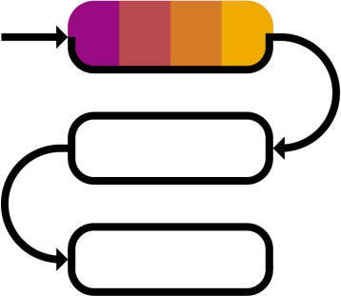
Prerequisites
SAP Signavio Process Intelligence: from prerequisites to successful data import
Contributors
Process expert (SME)
Data specialist
Business analyst
Connectivity
Enterprise systems
Databases
Cloud storages and warehouses
Other
On-premise extractor
Process requirements
Structured process data
Trace data with cases, events and timestamps

Slide 50



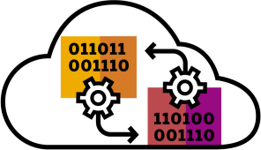
Connectivity
SAP Signavio Process Intelligence: from prerequisites to successful data import
Enterprise Systems
SAP ECC
SAP S/4HANA (all editions)
SAP SuccessFactors
ServiceNow
Jira Software
Databases
SAP HANA
MySQL
PostgreSQL
Other
Manual upload (e.g., csv)
Ingestion API
Elastic
OData
Microsoft SQL Server
Cloud Storages and Warehouses
SAP Data sphere (prev. DWC)
Amazon Athena & Amazon S3
Google Big Query
Snowflake

Slide 51





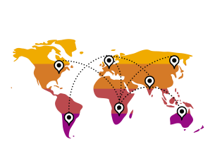


SAP Signavio Process Intelligence: from prerequisites to successful data import
Transformation templates for different processes
Procure-to-Pay Invoice-to-Pay Order-to-Cash Invoice-to-Cash
Operate-to-Maintain Plan-to-Fulfill Meter-to-Cash many more ..

Slide 52
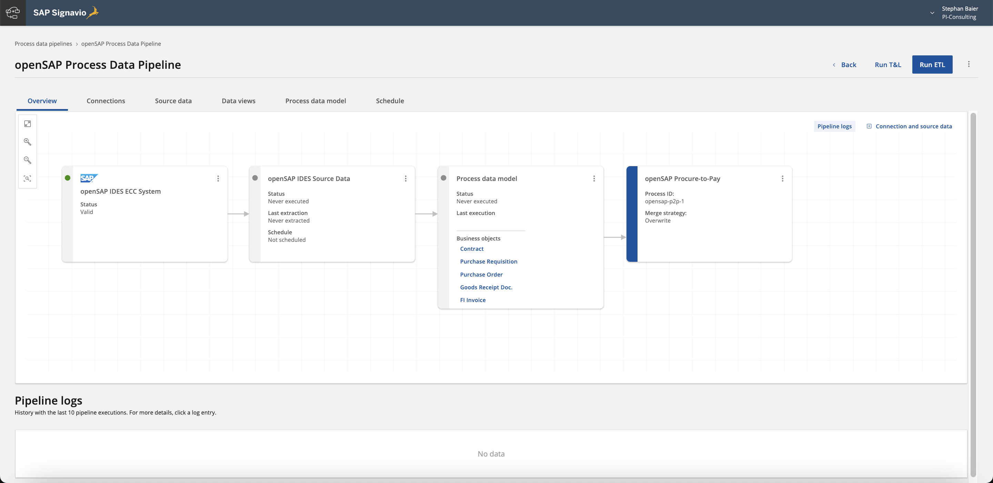
SAP Signavio Process Intelligence: from prerequisites to successful data import
Process data pipeline (PDP)
Detailed views for each step and setting
Steps of the Extract, Transform & Load (ETL) process
Log for extractions, transformations, and loads

Slide 53








































Slide 54








































































Slide 55













Slide 56

UNIT 3: Analyze and Enhance
3:6- SAP Signavio Process Intelligence in Action – Part 1

Slide 57
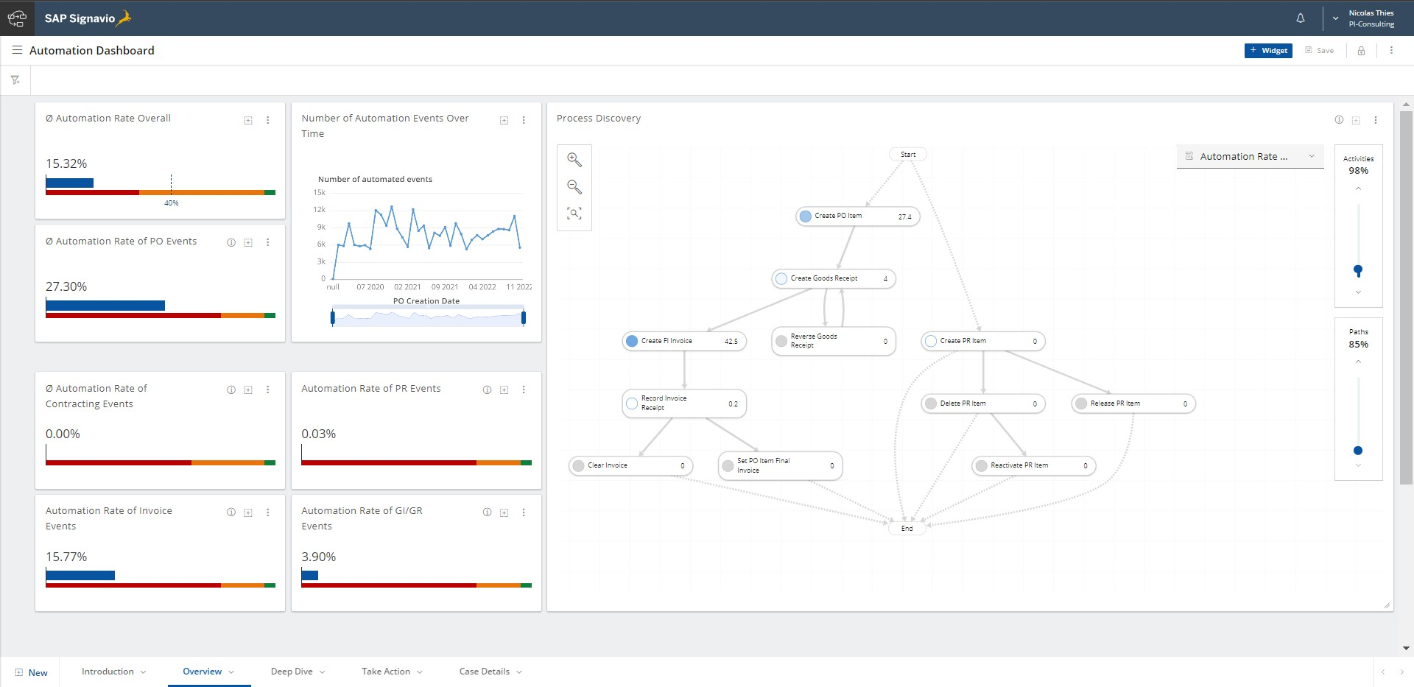
Example: out-of-the-box dashboard
SAP Signavio Process Intelligence in action – part 1

Slide 58
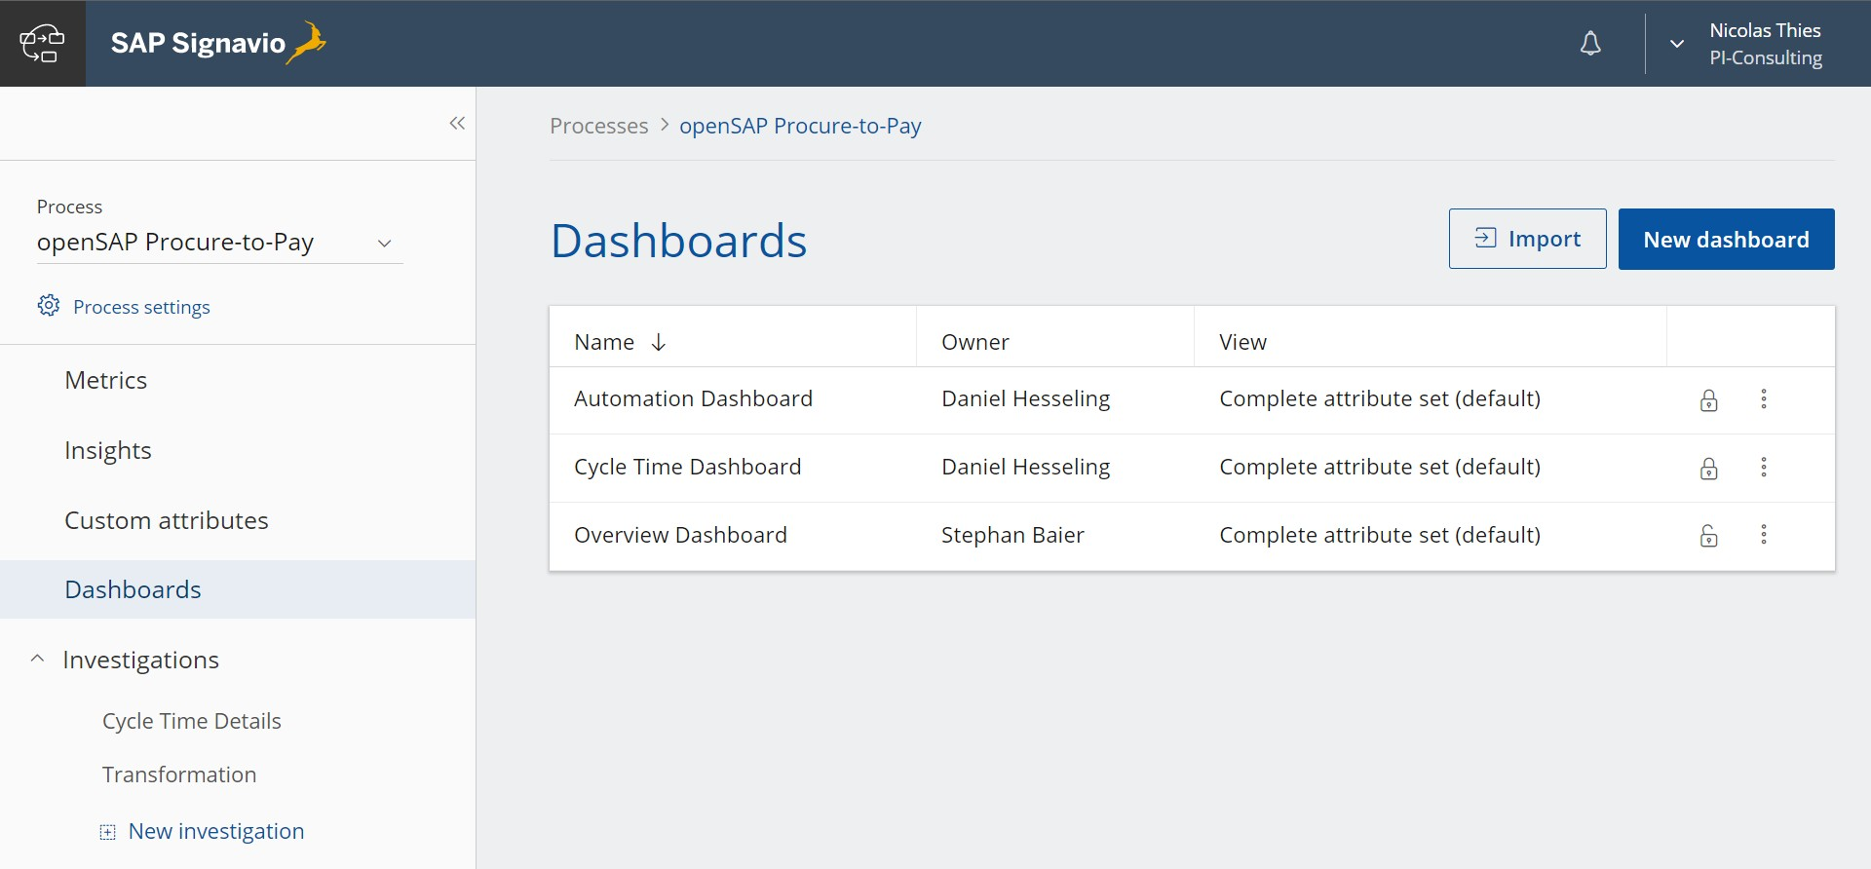
SAP Signavio Process Intelligence in action – part 1
Get started: dashboard creation
Create or import existing dashboard

Slide 59
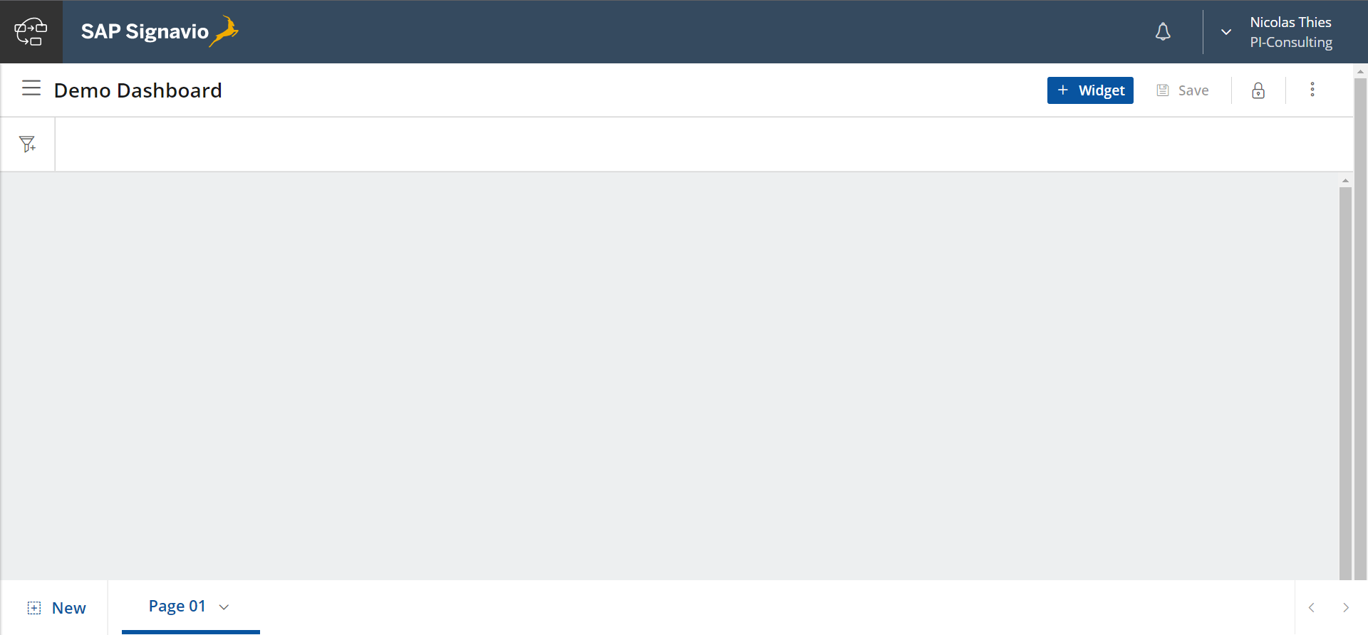
SAP Signavio Process Intelligence in action – part 1
Get started: dashboard creation
Create widgets
Filter data
Dashboard pages

Slide 60
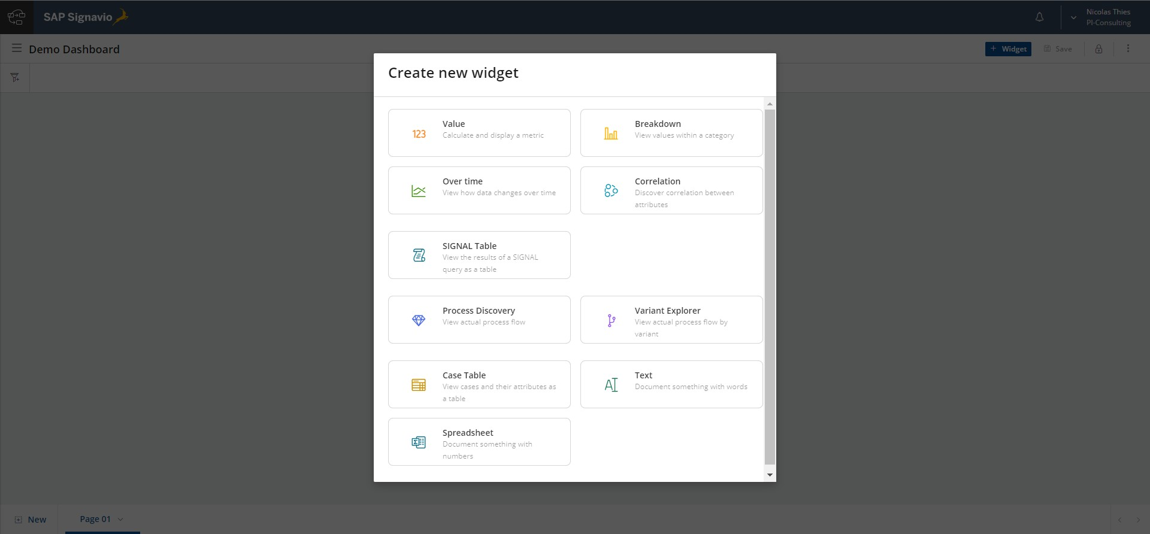
Create a widget
SAP Signavio Process Intelligence in action – part 1

Slide 61
What is SIGNAL
SAP Signavio Process Intelligence in action – part 1
SIGN
A
L
SIGNAL is our dedicated query language for process analysis. Read more in our SIGNAL guide.
Signavio
Analytics
Language
It provides an “editable backend” to
create more in-depth process queries
retrieve data and perform calculations, independent of the “clickable” interface
visualize results in more meaningful charts
Benefits of using SIGNAL
Run queries for process-related behavior and KPI computation
SQL-oriented – and easy to learn
More specific process-related queries
(not possible with standard “BI software“)
More meaningful visualizations

Slide 62
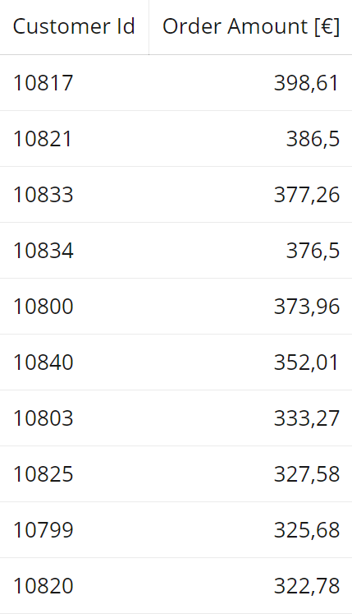
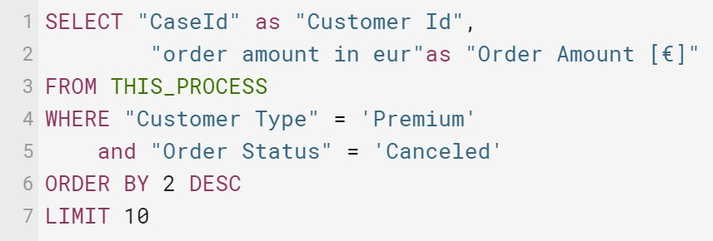

What is SIGNAL
SAP Signavio Process Intelligence in action – part 1
With SIGNAL code you can build custom queries to help solve more complex business questions
e.g., basic queries might include SiGNAL statements to:
select only specific columns
filter for certain values
sort results
…

Slide 63
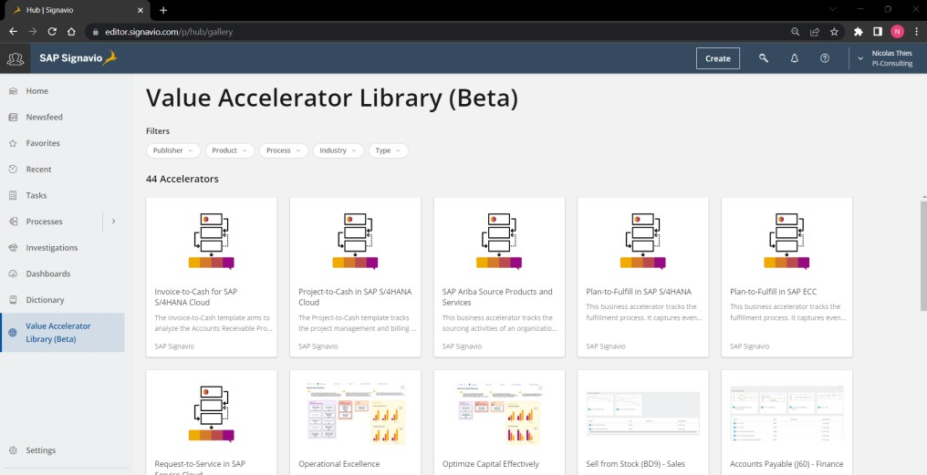
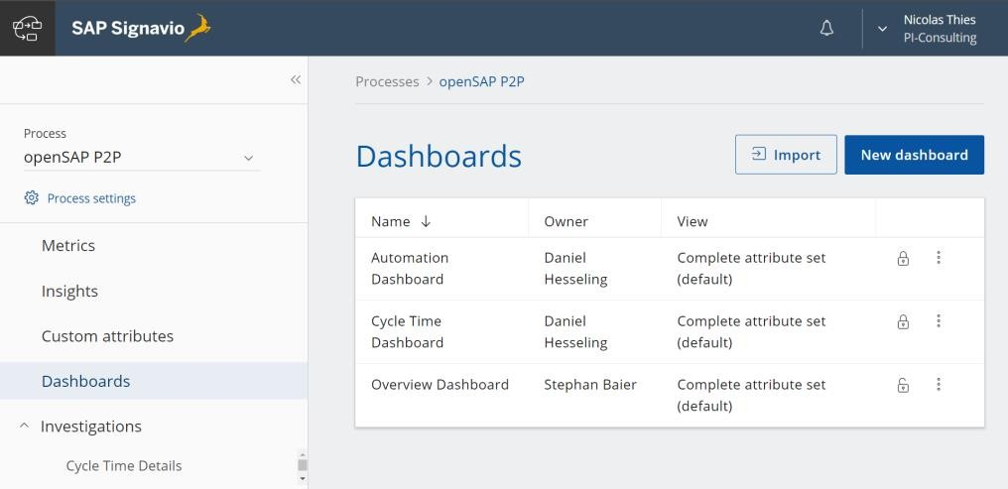
SAP Signavio Process Intelligence in action – part 1
Fast time to value – value accelerator library and out-of-the-box templates
Value accelerator library for SAP Signavio solutions in SAP Signavio Process Collaboration Hub
Find ready-to-use, standard out-of-the-box dashboard, extraction and transformation templates
Fast time to value

Slide 64

UNIT 3: Analyze and Enhance
3:7-SAP Signavio Process Intelligence in Action – Part 2

Slide 65















SAP Signavio Process Intelligence in action – part 2
SAP Signavio Process Intelligence Metric library
200+ pre-built process performance indicator metrics
Business Analysis Objectives
Increase automation
Ensure conformance
Reduce cycle time
Reduce dropouts
Reduce rework
Enforce SLAs
Investigations & Dashboards: Perform detailed process analysis.
Insights: Identify and collaborate.
Actions: Execute and alert.
Live Insights:
Key metrics on any canvas/diagram.
Analytic tools for everyone Different analysis tools to cater for individual needs of user groups throughout the analysis to insight lifecycle.
Metric recommendations for 13+ process types across various industries and process domains
Business Users, Analysts
Business Users, Analysts
Business Users, Analysts
Business Users, Execs
Metric Library
Empowering business users The metrics library empowers business users to leverage the computational power of the SiGNAL mining engine without technical knowledge.
Metrics
Business Rules
SiGNAL Mining Engine
Process Data Management (PDM / ETL)
Instant connectivity
The configurable ETL pipelines allow to extract data from major applications at the click of a button.
based on predefined event logs for SAP and non-SAP processes
3

Slide 66
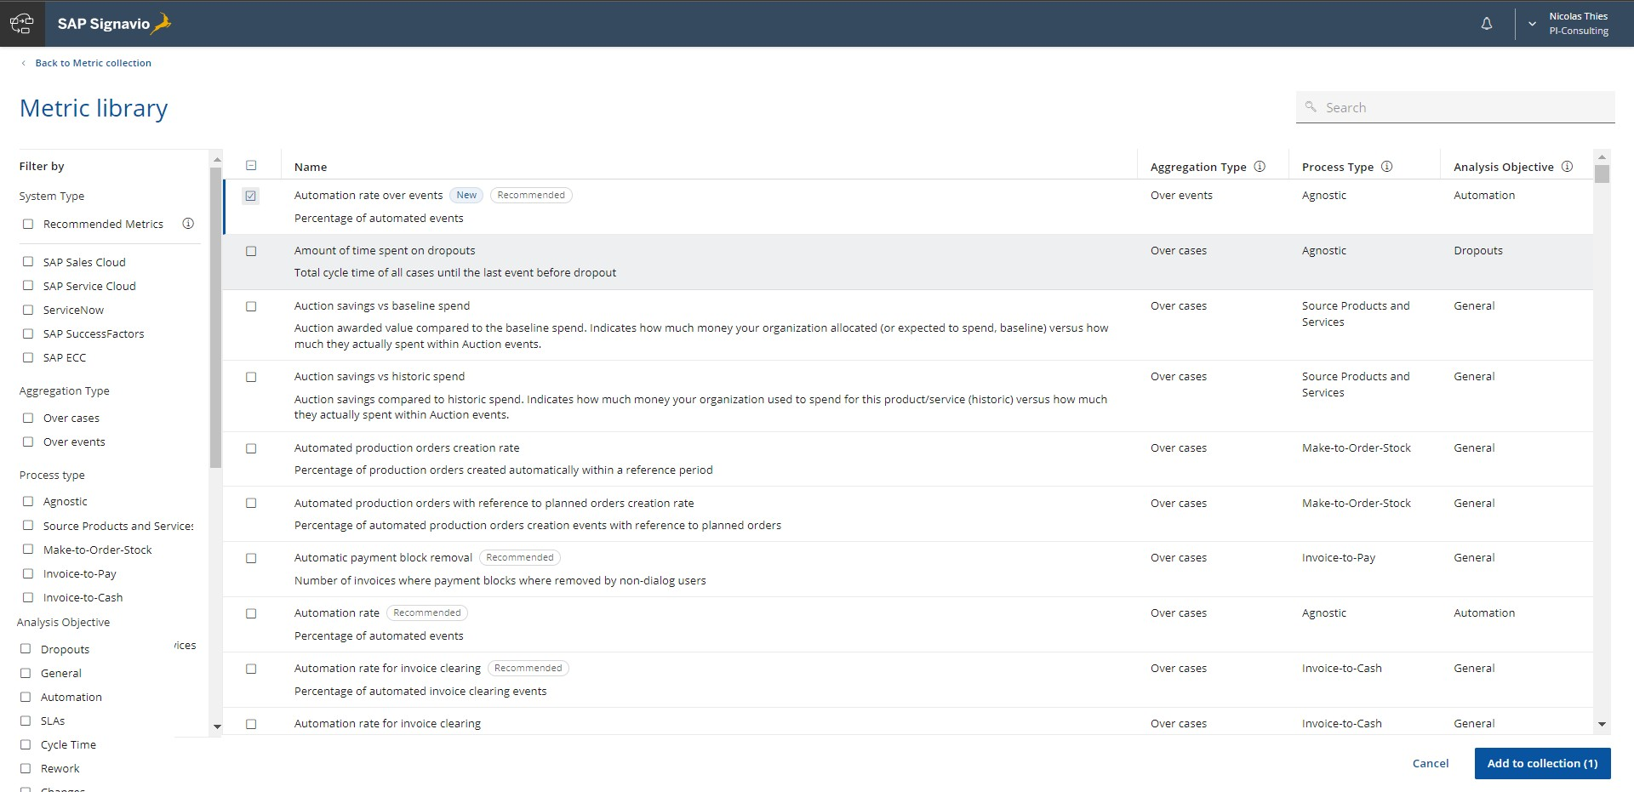
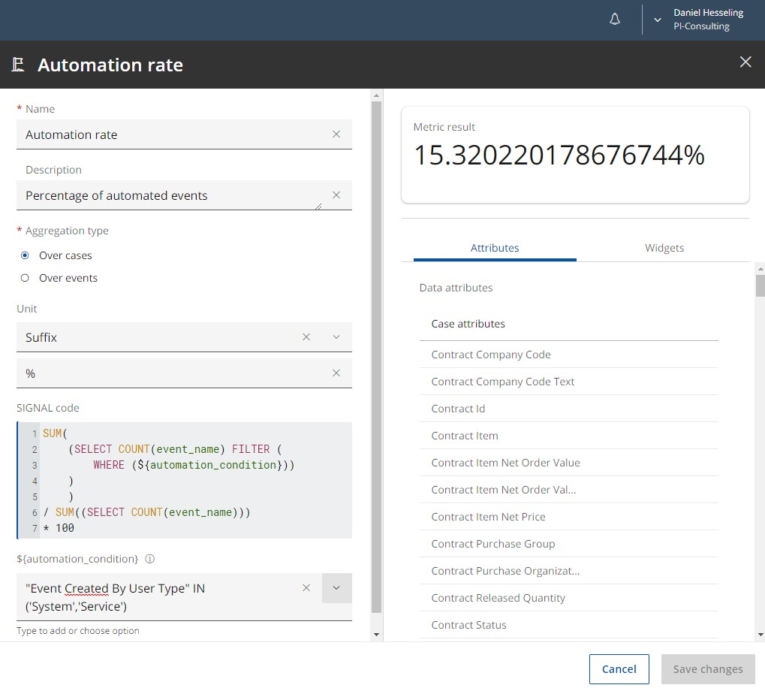
SAP Signavio Process Intelligence in action – part 2
SAP Signavio Process Intelligence Metric library
Choose metrics based on your system type, process type or analysis objective
Modify metrics based on your custom needs or reuse existing variables based on your defined system type

Slide 67
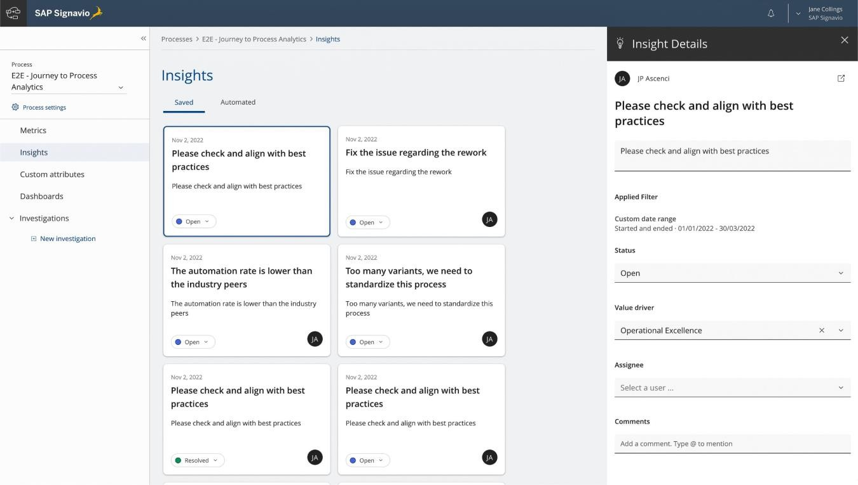
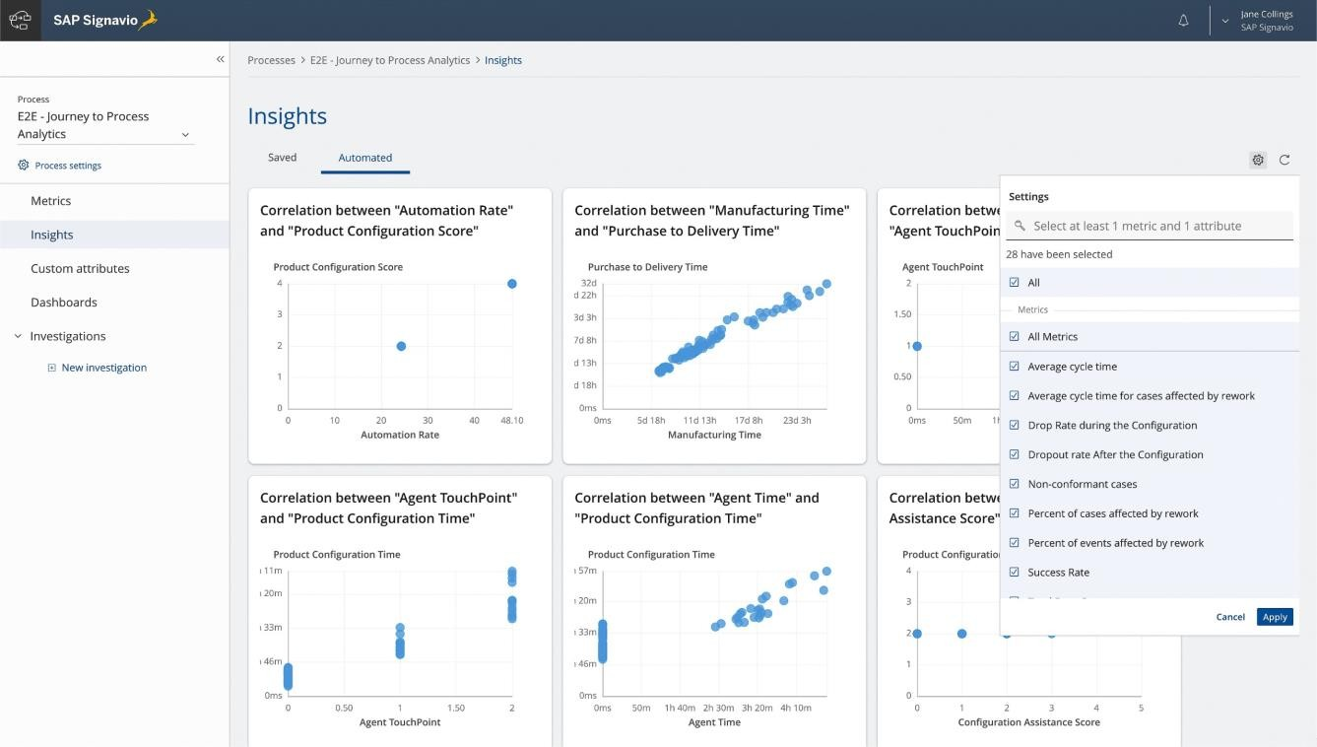
SAP Signavio Process Intelligence in action – part 2
SAP Signavio Process Intelligence Insights
Generate automated insights in Process Intelligence based on specified metrics and attributes to find unknown behaviors and correlations
Use Insights in Process Intelligence to collaborate on your findings and track your continuous business process transformation

Slide 68
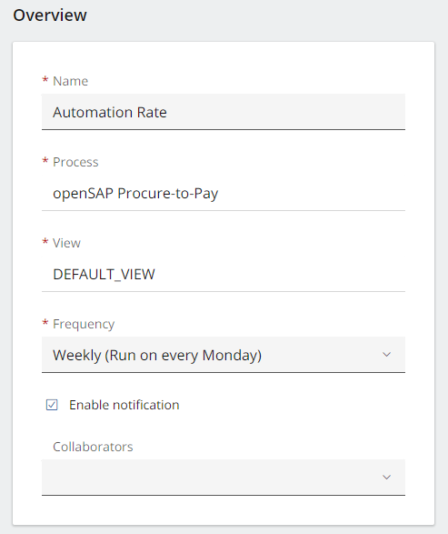
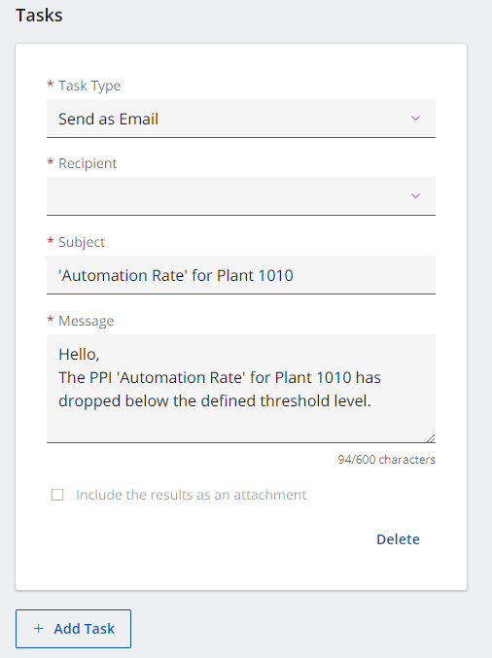


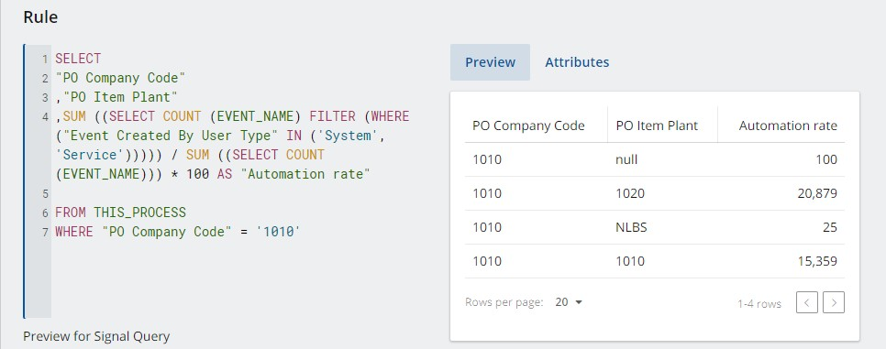


SAP Signavio Process Intelligence in action – part 2
SAP Signavio Process Intelligence Actions
Based on defined rules, queries will be calculated with a specified frequency to alert you and directly give you the ability to trigger actions.
Send an email to notify relevant stakeholders
about your insights
Integrate seamlessly with SAP Build Process Automation to trigger an approval workflow or automation bot
Connect to any web service endpoint you want using Webhook
Notify your colleagues directly in MS Teams

Slide 69

End Day-3

Slide 70


Do You Have Any Questions

Slide 71


Anubhav Oberoy

Slide 72





We build the workforce of the future.​
We’re committed to empowering you
to be​ the Most Desirable Resource​
through powerful training solutions.​
250+
Corporate Clients
30000+ Learned Trained
25000+ Learned Placed
Enroll Now
www.anubhavtrainings.com
FREE WEBINARS ​
Sign up for free webinars with industry experts every fortnight!

